Slide 1
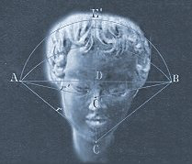
Lecture 2: Four Limitations of Personal Experience; the Scientific Method in Personality Psychology
Psych 350
R. Chris Fraley
http://www.yourpersonality.net/psych350/fall2015/

Slide 2
Psychology
the methods of psychology
the themes of psychology
Natural Science
Psychology, like the humanities, is concerned with fundamental issues concerning human experience. However, psychologists use the methods of the natural sciences to learn about psychological phenomena.
Philosophy & Humanities

Slide 3
Why Do We Need the Scientific Method in Order to Study Personality?
The methods we tend to use are subject to severe limitations.
We tend to rely upon personal experience and authority in constructing our beliefs about the world.
What are the limitations of these methods for understanding the world?

Slide 4
Class Exercise
In the following exercise, I will ask you to make judgments about the personality of a person named Josh.
I will present you with a number of brief descriptions of Josh, taken from statements made by Josh and some of his friends.
After you have had a chance to read each statement, I’ll ask you some questions about Josh.
Before we begin, we need two groups. Group 1 = Heads (H) and Group 2 = Tails (T)

Slide 5
Group Tails close your eyes

Slide 6
Group Heads
Your goal is to answer the following question:
Is Josh an extraverted (i.e., social, high-energy, outward-focused) individual?

Slide 7
Group Heads: Close your eyes
Group Tails: Open you eyes

Slide 8
Group Tails
Your goal is to answer the following question:
Do you think Josh is a relatively intelligent person?

Slide 9
Everyone can look

Slide 10
Characteristics of Josh
Josh studies had and takes his courses seriously.
Josh likes to hang out with his friends at the local pub.
“Cherry Garcia” is Josh’s favorite kind of ice cream.
Josh is in his fourth year of college at UIUC.
Josh spends a lot of time on Facebook.
Josh can be shy when he is meeting someone for the first time.
Josh is an “early bird,” and often gets up at dawn.
Josh enjoys meeting and interacting with new people.
Josh loves Thai food.
Josh claims he spends too much money buying music.

Slide 11
Now
Take 60 seconds to write down as many of the statements as you can recall.

Slide 12
Now
One last question: Would you describe Josh as an extravert (i.e., someone who is relatively social, outgoing, and energetic)?
Answer Yes or No

Slide 13
Four Limitations of Personal Experience
1. The Confirmation Bias and the Discounting Problem. We tend to seek out information that is consistent with our expectations. Moreover, sometimes we discount information that is inconsistent with those expectations.

Slide 14
Four Limitations of Personal Experience
This class exercise generally demonstrates that people who are trying to answer the question “Is Josh Extraverted?” are more likely to conclude that Josh is extraverted.
  How many people in the Heads group said “Yes?” compared to the Tails group?
In the process, information that is inconsistent with that judgment (i.e., “Josh can be shy when he is meeting someone for the first time”) is sometimes ignored or forgotten.
  How many people in the Heads group recalled this item?

Slide 15
Four Limitations of Personal Experience
2. The Limited Data Problem. We tend to make inferences on the basis of very little information.

Slide 16
Four Limitations of Personal Experience
In psychology, this strategy is problematic because behavior is probabilistic and multi-determined.
Even highly extraverted or sociable people behave shyly in some circumstances. Thus, when we draw inferences based on a limited amount of information, we are impairing our ability to make the correct assessment.

Slide 17
The Dangers of CHC
More than 98 percent of convicted felons have tested positive for CHC.
99.7% of the people involved in auto accidents used a substance containing CHC within 6 months preceding the accident.
93.1% of juvenile delinquents come from neighborhoods where CHC is used frequently.

Slide 18
The Dangers of Bread
More than 98 percent of convicted felons are bread users.
99.7% of the people involved in auto accidents ate bread within 6 months preceding the accident.
93.1% of juvenile delinquents came from homes where bread is served frequently.

Slide 19
Four Limitations of Personal Experience
3. The Baserate/Comparison Group Problem. We tend to overlook the fact that inferences about associations require some kind of comparison or standard.
A related issue: The Big Numbers Problem. We assume that big (or small) percentages are important, even when appropriate comparison data are not available.

Slide 20
Example
Does eating chicken soup decrease cold severity?
What if we were to learn that 7 of 10 (70%) of people with a cold who had chicken soup started to feel better after 5 days?

Slide 21
Example
That Big Number is inadequate.
Why? Maybe 7 out of 10 (70%) people with a cold who didn’t have chicken soup started to feel better after 5 days too.

Slide 22
Chicken Soup
No
Yes
7
7
Feel Better
Effect
3
3
Feel Same or Worse
7/10 felt better
7/10 felt better

Slide 23
Chicken Soup
No
Yes
5
7
Feel Better
Effect
5
3
Feel Same or Worse
5/10 felt better
7/10 felt better

Slide 24
Four Limitations of Personal Experience
4. The Pleasant Truth Problem. We tend to believe an idea is true if the idea makes us feel good.

Slide 25
How do these propositions “feel” to you?
Peoples’ financial success in life is largely a function of the social status of the families they are born into and not their hard work or education per se.
As a parent, how you rear your children plays virtually no role in whether your children grow up to become criminals or law-abiding citizens.
Our conscious existence ends with physical death.
Our thoughts, emotions, personality, and sense of self can be changed by simply altering the biochemistry of the body.
Morality and altruism “evolved” in people via the process of natural selection.
There is no “beyond the obvious” symbolism in our dreams.

Slide 26
Reality
False
True
Pleasant Falsehoods
Pleasant Truths
Feels Good
Feeling
Unpleasant Falsehoods
Unpleasant Truths
Feels Bad

Slide 27
What we tend to believe
Reality
False
True
Pleasant Falsehoods
Pleasant Truths
Feels Good
Feeling
Unpleasant Falsehoods
Unpleasant Truths
Feels Bad

Slide 28
What we need to believe to be correct
Reality
False
True
Pleasant Falsehoods
Pleasant Truths
Feels Good
Feeling
Unpleasant Falsehoods
Unpleasant Truths
Feels Bad

Slide 29
Interim Summary
To summarize: The way people tend to gather information is not systematic
  we tend to seek information that is consistent with our beliefs and ignore inconsistent information
  we tend to base our inferences on little information
  we’re not attentive to base rates and comparisons
  we tend to assume that propositions that feel wrong to us are invalid

Slide 30
Why are these “limitations?”
In conjunction, these factors can lead to two problems for developing an accurate understanding of human personality.
  First, these factors can lead us to the wrong answer.
  Second, the process itself is not self-correcting.

Slide 31
1. The Wrong Answer
As we demonstrated in the “Josh” exercise, people who were seeking to answer different questions recalled different kinds of information about Josh.
People who were attempting to determine whether Josh was extraverted were more likely to conclude that he was compared to people who were not evaluating his extraversion explicitly.

Slide 32
2. Why the Process is not Self-correcting
The confirmation bias helps to ensure that, once an expectation or theory has been developed, the belief will be self-perpetuating.
Is Josh extraverted?
We then recall/notice extraverted-consistent information better, and fail to recall/notice introverted information
We conclude that Josh is extraverted

Slide 33
What we want:
  methods that are more likely to lead us to the right answer
  a process for understanding the world that will enable us to correct the inevitable mistakes that we will make

Slide 34
The Scientific Method
The scientific method is a way of dealing with these concerns.
Science is the process of constructing, testing, and refining theories about natural phenomena though the use of systematic empirical observation.

Slide 35
Systematic
By systematic, I mean that that all information counts, regardless of whether it is consistent or inconsistent with our assumptions or how it makes us feel.
Moreover, by systematic I mean attending to base rates, collecting a sufficient amount of information, recognizing and correcting for potential biases.
In short, trying to be as true as possible to what really happens in the world.

Slide 36
How is the process self-correcting?
theory about how something works
testing: comparing the observations with the theory
generating predictions
(what would the theory lead you to observe?)
systematic empirical observations

Slide 37
How is the process self-correcting?
theory about how something works
testing: comparing the observations with the theory
Coffee makes you happy
generating predictions
(what would the theory lead you to observe?)
systematic empirical observations

Slide 38
How is the process self-correcting?
theory about how something works
testing: comparing the observations with the theory
People who drink coffee should be happy
generating predictions
(what would the theory lead you to observe? What would it lead you to not observe?)
systematic empirical observations

Slide 39
How is the process self-correcting?
theory about how something works
People who drink coffee should be more happy compared to people who do not
ensures that inconsistent observations will be recorded (think about 2x2)
testing: comparing the observations with the theory
generating predictions
(what would the theory lead you to observe?)
systematic empirical observations

Slide 40
Happy
Not Happy
Coffee
No Coffee

Slide 41
How is the process self-correcting?
theory about how something works
testing: comparing the observations with the theory
ensures that inconsistent observations will be counted against the theory
generating predictions
(what would the theory lead you to observe?)
systematic empirical observations

Slide 42
Happy
Not Happy
Coffee
10 consistent
1 inconsistent
No Coffee
1 inconsistent
8 consistent

Slide 43
How is the process self-correcting?
theory about how something works
testing: comparing the observations with the theory
theory is revised in light of the tests, and, hopefully, becomes more accurate
generating predictions
(what would the theory lead you to observe?)
systematic empirical observations

Slide 44
Two caveats concerning “science”
First, science is a method—a way of collecting and evaluating data that values being systematic above all else.
Science is not a topic area.

Slide 45
Two caveats concerning “science”
Second, just because something is called a “science” doesn’t mean that it is scientific in the way we’ve described.

Slide 46
Science and Pseudo-science
There are tons of nonscientific “self-help” books in the world, and these are featured predominantly in the psychology section of bookstores.
There are over 400 distinct kinds of psychotherapy (including equine therapy).
“Experts” from psychology and business schools are regularly featured in television shows, podcasts, op-eds.
Subliminal recordings are readily available to improve your memory or to help you lose weight.

Slide 47
Science and Pseudo-science
In short, psychological knowledge, like many things in the world, can be—and is—sold to the public.
Why is this a problem for a new generation of psychology majors?

Slide 48
Why is this a problem for a new generation of psychology majors?
Very few of these purveyors of psychological knowledge have training in or an appreciation for the scientific method.
How do we know whether their ideas are correct or whether their “products” work?

Slide 49
Example: Subliminal Recordings
Subliminal recordings contain recordings that are designed to help you achieve certain goals (e.g., lose weight, increase your confidence, quit smoking).
Typically, there are two “tracks” on these recordings. One contains peaceful, soothing music. The other contains a spoken message that is recorded at a low volume. These messages are typically too quiet for you to detect consciously (“subliminal”).

Slide 50
Do they work?
People who create and sell these recordings presumably do so because these recordings actually help people.
What kind of evidence is there that these recordings work?

Slide 51
Multimedia class exercise
Let’s do a Google search on “subliminal recordings” and see what kind of information is available from sellers about the effectiveness of the products.
Two of the most popular sites:
  hypnovision.com
  subliminal-tapes.com

Slide 52
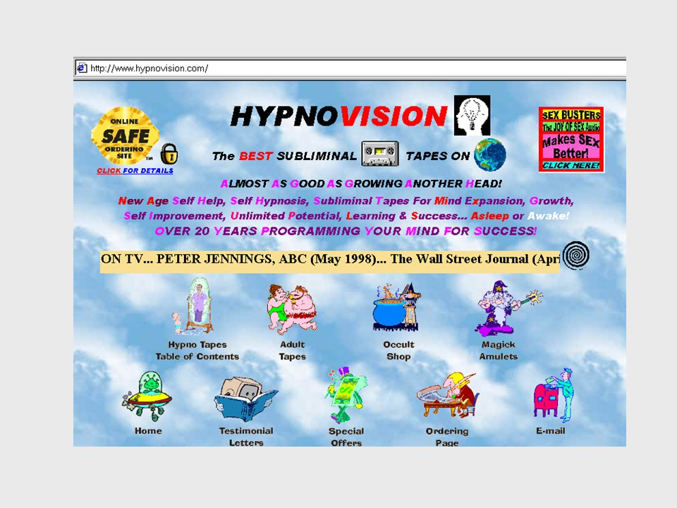

Slide 53
FOR THOSE OF YOU SKEPTICS OUT THERE WHO WRITE
THESE FAQ's (frequently asked questions)
1- "DO THE TAPES REALLY WORK?"
THINK ABOUT IT... IF THE TAPES DIDN'T WORK WOULD YOU EXPECT ME TO SAY NO!
HYPNOVISION TAPES CAN ONLY HELP PEOPLE WHO ARE OPEN MINDED, HAVE FAITH, TRUST, BELIEF, HOPE AND ARE WILLING TO TAKE A CHANCE IN LIFE WITHOUT ASKING FOOLISH & STUPID HOLLYWOOD / TV TYPE QUESTIONS! FOR THOSE of YOU WHO BELIEVE IN The POWER of the MIND,
IN MAGICK, IN METAPHYSICS OR SPIRITUALITY...
No Explanation of How These Tapes Work Is Necessary!
For those of you who DO NOT BELIEVE ...
NO EXPLANATION IS POSSIBLE!
Close minded people, agnostics & skeptics listen...
Our tapes are not for you!
FOR THE REST OF YOU SEEKERS & PEOPLE
ON THE PATH OF GROWTH & ENLIGHTENMENT...
I WILL NEVER DISCOURAGE THE ASKING OF
QUESTIONS BECAUSE THEY ARE MOSTLY
MEANINGFUL & IMPORTANT TO YOU SO PLEASE...
FEEL FREE IF THE NEED ARISES TO CONTACT ME:

Slide 54
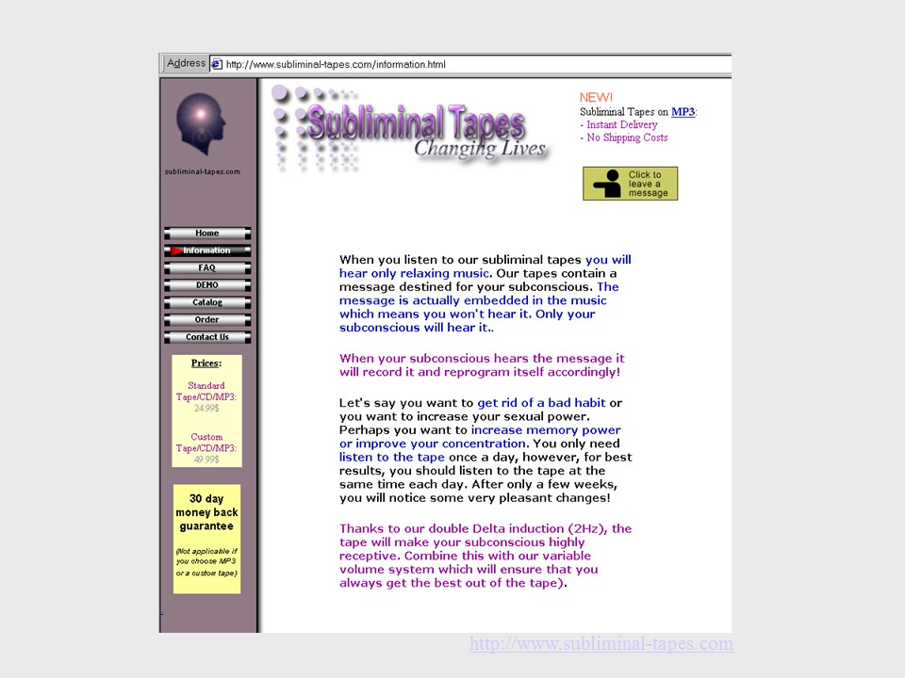

Slide 55
Studied for exams while listening to Deep Relaxation. Found I could study for longer periods of time and experienced less anxiety during exams. I have been using the tapes for a relatively short time and I can notice clear positive shifts in my attitudes towards life and my problems. Stop Smoking, it’s worked! Prosperity, I now have sufficient income to support our needs. It was very tight before hand.
L Wood
I bought Weight Control because over winter I had added a couple of kilos. I have since lost that weight and I have also lost the desire to eat much of the sweet food I was before. I also bought Attracting Infinite Riches. Since then my job has gone from 2 days a week casual labour to joint supervisor! Keep up the good work.
E Little
Your tapes are fantastic! I have Self Confidence and noticed the change on an inner level after about a week. Now my mum uses them as well (she bought her own!) and I’m ready to try some new ones. Thank you.
L Wheeler, Qld
I have been using several tapes for almost a year now and have found them to be most effective. They help you to understand that you can change your mind literally -- and keep it that way. Peak Performance, Memory, Concentration and Joy of Learning are stand out performers and I would not hesitate in recommending them to anyone, regardless of age. Thank you Alphasonics!
Steve O'Connor, NSW

Slide 56
What are the limitations of these methods?
Confirmation bias:
  testimonial evidence generally doesn’t include dissatisfied customers. The expectations that customers have concerning the tapes may influence their perceived effectiveness. There is no evidence on these sites that this kind of consideration has been taken into account.
Amount of information:
  unknown
Expectations: Base rates/comparison:
  We don’t know what happens to people if the message isn’t really in the recording
Feels good = Truth:
  It probably makes people who make and buy these tapes feel good to think that they work. This might lead them to assume the tapes really work, regardless of whether they do.

Slide 57
What are the limitations of these methods?
Confirmation bias:
  testimonial evidence generally doesn’t include dissatisfied customers. The expectations that customers have concerning the tapes may influence their perceived effectiveness. There is no evidence on these sites that this kind of consideration has been taken into account.
Amount of information:
  unknown
Expectations: Base rates/comparison:
  We don’t know what happens to people if the message isn’t really in the recording
Feels good = Truth:
  It probably makes people who make and buy these tapes feel good to think that they work. This might lead them to assume the tapes really work, regardless of whether they do.

Slide 58
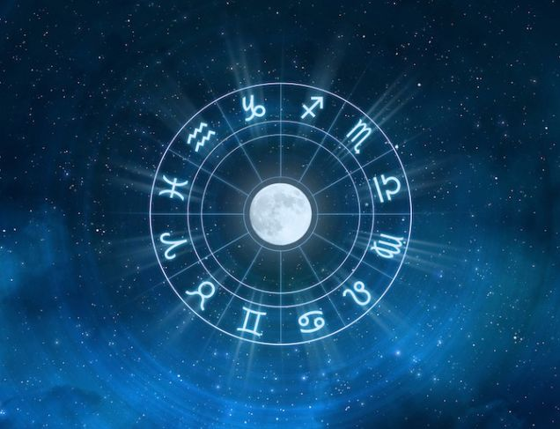
Do seemingly pseudo-scientific need to be pseudo-scientific?

Slide 59
Horoscope Demonstration
Aries 21 March – 20 April
Taurus 21 April – 21 May
Gemini 22 May – 21 June
Cancer 22 June – 22 July
Leo 23 July – 22 August
Virgo 23 August – 23 September
Libra 24 September – 23 October
Scorpio 24 October – 22 November
Sagittarius 23 November – 21 December
Capricorn 22 December – 20 January
Aquarius 21 January – 19 February
Pisces 20 February – 20 March

Slide 60
Cautions about “science”: Science as a Process versus Science as an Ideal
Obviously, people who are using the scientific method suffer from many of the problems we’ve described.
The scientific process is an ideal; one that we strive to achieve, but do not necessarily achieve.
The onus is on you to be able to separate good science from pseudo-science. (In taking this course, I hope you’ll learn how to make these distinctions.)

