Slide 1

Creating Internet Surveys and Collecting Data Using HTML
Lecture 4, Psych 350 - R. Chris Fraley
http://www.yourpersonality.net/psych350/fall2015/

Slide 2
Goals
The goal of this lecture is to explain how you create relatively simple webpages that can be used to collect data for research purposes.
  We’ll be using this method for some of the research assignments and at least one major project.
  Potentially complex topic; practice the methods a bit.
  If you know a bit about web programming already, please follow along in our sandbox for the purposes of class assignments. Doing so will help us ensure that everyone is able to do some core things. If you’re super confident in your skills, however, feel free to do your own thing—as long as it also allows you to complete class assignments adequately.

Slide 3
HTML web pages
Most web pages are written in a “language” called HTML (hypertext markup language).
HTML files exist on a web server. When a person types in the URL for a specific file in his or her web browser, the person is essentially retrieving that pre-existing file from the web server.

Slide 4
How the Process Works
web user
types a URL into the browser
web server
locates requested HTML file (or runs a script) and sends the requested HTML file (or script output) to user’s computer
web user
the browser renders the HTML file as a web page

Slide 5
HTML
There are many programs that are designed to help you create HTML files
  Macromedia’s Dreamweaver
  Microsoft’s FrontPage
  Microsoft’s Word
These kinds of programs are often called WYSIWYG programs. They allow you to create web pages in the way in which you want them to appear; the HTML code is generated in the background.

Slide 6
EditPlus
There are good reasons to learn to write your own HTML
Free Code Editors
  Mac/iOS – Text Wrangler
    http://www.barebones.com/products/textwrangler/
  PC/Windows - Notepad ++
    http://notepad-plus-plus.org/
Regardless, do NOT use MS Word. Use a basic text editor (e.g., Notepad in Windows) if you do not use a program specifically for HTML coding. You can use Notepad, but you’ll need to be careful. Notepad will often force the file extension to be *.txt even when you explicitly choose an alternative extension (e.g., *.html).

Slide 7
Let’s begin . . .

Slide 8
[Live examples of creating HTML code using TryIt Editor at http://www.w3schools.com/html/tryit.asp?filename=tryhtml_headers]

Slide 9
HTML Tags
HTML web pages are based on a combination of text and tags.
Tags are programming commands used to modify the contents of a web page. They are used, for example, to change the color of the text, the size of the text, insert images, etc.
Example: <B> and </B>
Most (but not all) tags have an “opening” and “closing” tag. The opening tag is used to tell the browser that a new command is coming and the closing tag tells the browser that the command is complete.

Slide 10
HTML Tags
The most basic tag is the HTML tag. This is used so the browser will know that the content to follow is HTML code/content. (Most browsers assume this by default even without the use of the HTML tag.)
<HTML>
</HTML>

Slide 11
HTML Tags
Any text that is placed in-between these tags will be rendered by the browser.
Try this example.
<HTML>
The purpose of this study is to learn more about personality.
</HTML>

Slide 12
HTML Tags - Bold
Text can be formatted in ways that will be familiar to you if you use a program like MS Word.
To set something in bold, use the <B> </B> tags and include the piece to be set in bold in-between.
Try this example.
<HTML>
The purpose of this experiment is to learn more about the way <B>people</B> understand <B>machines</B>.
</HTML>

Slide 13
HTML Tags - Italics
Italics work in the same way. The HTML tags for setting text in italics are <I> and </I>
Try this example.
<HTML>
Although the average score in this sample is 4.23, <I>your score</I> was 6.32.
</HTML>

Slide 14
Font size and color
To augment the font color or size, you can use the <FONT> </FONT> tags.
Note: The font tag is the first of several tags we will discuss that have attributes or parameters. For example, when setting the font, you can adjust the face, the size, and the color. The examples will make this clear.
<HTML>
<FONT SIZE='2' FACE='arial' COLOR='blue'>
Welcome to my web page!
</FONT>
</HTML>

Slide 15
Font size and color
Another example.
<HTML>
<FONT SIZE='3' FACE='arial' COLOR='blue'>
Psychology 350
</FONT>
<FONT SIZE='2' FACE='arial' COLOR='blue'>
Welcome to our class web page!
</FONT>
</HTML>

Slide 16
Line spacing
In HTML, carriage returns are not coded as line breaks. You can use them all you wish to format your file, but the presence of a return in the code will not affect the rendering of the text.
To insert a line break, you must include a tag for it.
The line break tag is <BR>. There is no closing tag.

Slide 17
Line spacing
Try this example.
<HTML>
<FONT SIZE='3' FACE='arial' COLOR=blue>
Psychology 350
</FONT>
<BR><BR>
<FONT SIZE='2' FACE='arial' COLOR='blue'>
Welcome to our class web page!
</FONT>
</HTML>

Slide 18
Blank Spaces
Blank spaces work in a similar way: Any space (greater than 1) that exists in the HTML code will not be rendered.
If you want a sequence of blank spaces (e.g., for minor indenting), you have to include them explicitly.
The command is &nbsp
(Notice that this is not a tag per se, but it is still an HTML command. nbsp stands for Non-Breaking Space.)

Slide 19
Blank spaces
Try this example.
<HTML>
Factor 1<BR>
&nbsp &nbsp joy <BR>
&nbsp &nbsp happy <BR>
Factor 2<BR>
&nbsp &nbsp sad <BR>
&nbsp &nbsp shame <BR>
</HTML>

Slide 20
Centering Text
To center text, use the <CENTER> and </CENTER> tags
Try this example.
<HTML>
<CENTER>Personality Research 350</CENTER>
<BR><BR>
The purpose of this study is to learn more about the way people understand others.
</HTML>

Slide 21
Creating Links
A link is a portion of the page that, when clicked, automatically transports the user to a new page.
HTML code:
<A HREF='http://www.google.com'>click here to go to Google</A>
Note: The “A” stands for “anchor”. The HREF attribute is the URL for the page you want the user to go to when the link is clicked. The text in between the two tags will be what the user sees as the link.
Although there are many ways to specify the URL, the most reliable way to do so is to start with http:// and include the FULL URL that you would see on your browser address bar (see example above).

Slide 22
Cascading Style Sheets (CSS)
One of the cumbersome aspects of formatting text in classic HTML is the sheer number of tags required to do so. If you choose to change the “style” of your web page after a period of time, all of the code needs to be rewritten.
This is especially inconvenient when working with tables because the text has to be formatted separately within each cell.
CSS provides a means for separating style from content and is an efficient way to add pizzazz (not pizza) and personality to your web pages.

Slide 23
CSS
Any text that is placed in-between these tags will be rendered by the browser. Try this example.
<HTML>
<style type="text/css" media="all">
body {
color: white;
background: gray;
font-family: verdana;
font-size: 14;
line-height: 2;
}
</style>
Welcome to my web page!
</HTML>

Slide 24
You can define “classes” so that different portions of your content are styled differently.

Slide 25
CSS
Adjusting the way in which links behave.
<HTML>
<style type="text/css" media="all">
a:link { color: blue; }
a:visited { color: navy; }
a:active { color: pink; }
a:hover { color: red; background-color: blue;}
}
</style>
Welcome to my web page!<BR>
<A HREF='http://www.google.com'>click here to go to Google</A>
</HTML>

Slide 26
Images
You can use tags that enable images to be displayed on your web page.
Here is the basic code:
<img src='http://www.psych.uiuc.edu/~rcfraley/nauttext2.gif' width='240' height='240' alt='main graphic'>

Slide 27
Image Attributes
Notice that there are several attributes that can be varied: width, height, and alt (i.e., the text that appears when you hover your mouse over the graphic).
As with links, there are many ways to specify the address for the image. The surefire way to do it for the purposes of this class is to list the full URL for the image in question.
Importantly, for the purposes of this class, the image must already exist on the Internet. If there is an image on your computer, you cannot display it for others unless it is web-accessible.

Slide 28
Forms: How to collect data
The majority of web pages exist simply to provide content.
It is also possible to use web pages to collect information through the use of forms.
Forms are special segments of a web page that tell the browser that information is to be collected.

Slide 29
[Example of a web page using a form]
The live page is at:
http://www.yourpersonality.net/psych350/fall2015/testform1.htm
The HTML code for the page can be viewed (and copied) by “right-clicking” on the page and choosing the “view source” option in Windows or the equivalent on a Mac.

Slide 30
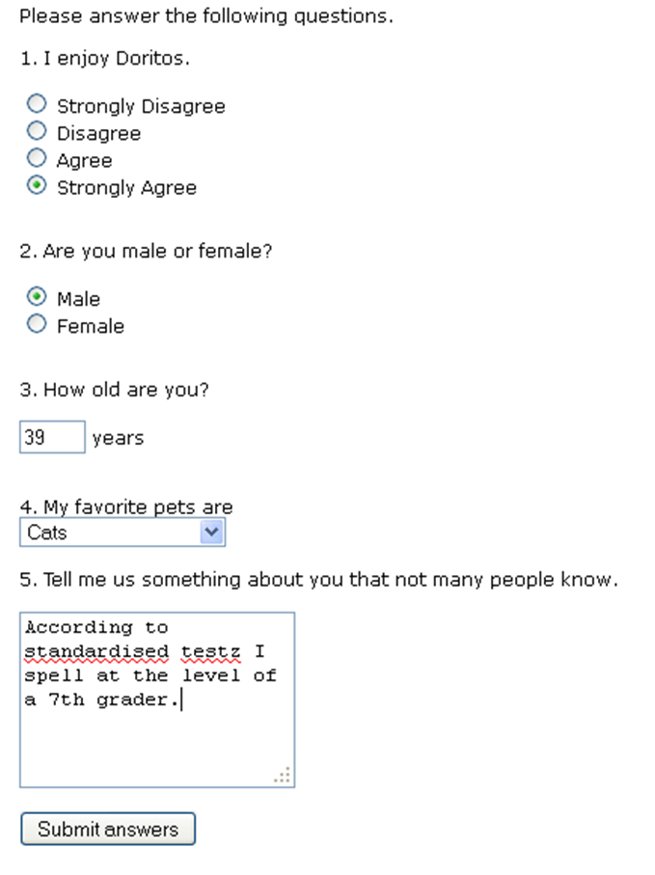
Note. The user provides input and clicks a ‘submit’ button when he or she is done.

Slide 31
Different input options
Radio buttons
Checkboxes [skipping in this class]
Textboxes
Select menus
Textarea
Review these in depth based on the online version of testform2.htm. Right-clicking to view the code of that page contains detailed comments and explanations.
http://www.yourpersonality.net/psych350/fall2015/testform2.htm

Slide 32
Variable Names
For the purposes of this class, please use variable names that represent the order of the variables in your questionnaire.
v01
v02
v03
v04
v05 … v10 v11 v12 . . . v20 v21 . . .
I tend to use “v” (for variable) followed by a number, with a leading 0 for the first 9 items. I STRONGLY encourage you to follow this convention also so you will not be confused when you download your data.

Slide 33
HTML Forms
The basic ingredients of an HTML form:
A <FORM> tag that specifies the action to be taken when the user submits the information
The input fields [questionnaire items]
One or more hidden tags to preserve information
    <INPUT TYPE='hidden' NAME='username' VALUE='coffeefan1'>
A submit button
    <INPUT TYPE='submit' VALUE='Submit answers'>
A closing </FORM> tag

Slide 34
HTML Forms
The form tag specifies, as part of the action attribute, the name of the script that will be activated when the submit button is pressed.
<FORM ACTION='http://www.yourpersonality.net/psych350/fall2015/genericsubmit.pl' METHOD='post'>
For the purposes of this class, you will always be using this exact line of code for your opening form tag. Never change this; copy and paste.

Slide 35
Overall structure in review
<HTML>
CSS stuff
<FORM ACTION='http://www.yourpersonality.net/psych350/fall2015/genericsubmit.pl' METHOD='post'>
  Note: This line never changes for the purposes of the work we do in this class
  Various input fields for collecting data using radio button inputs, select menus, text responses
  Hidden tag for author of survey
    Example: <INPUT TYPE='hidden' NAME='username' VALUE='coffeefan1'>
    Note: This will become the filename for data file itself. Make note of it and, for continuity, make it the same as the name of the HTML file you’re creating.
  Submit button
    <INPUT TYPE='submit' VALUE='Submit answers'>
</FORM>
</HTML>

Slide 36
Example
<INPUT TYPE='hidden' NAME='username' VALUE='christest'>
To see an example that you can essentially copy-and-paste and modify for your own purposes, please visit:
http://www.yourpersonality.net/psych350/fall2015/testform2.htm
Once there, right-click to view page source. You can then copy-and-paste that code and modify it yourself for your needs.
There are two key things you’ll have to change:
  1. You will need to use your own questionnaire items.
  2. Near the end you’ll need to modify the USERNAME tag to reference your alias and not mine. Examples:
  <INPUT TYPE='hidden' NAME='username' VALUE='jenny54'>
  <INPUT TYPE='hidden' NAME='username' VALUE='jiaisthebest23'>
  <INPUT TYPE='hidden' NAME='username' VALUE='wat2'>
Keep this part the same
Update this part

Slide 37
Transferring your web page to the web server
Save your file with the *.html extension. Example: coffeefan1.html
For many projects in this class, you will want to use your alias or username as the file name, with a number appended to it so that you can keep various assignments separated.
Example: If your alias is “coffeefan”
  coffeefan1.html
  coffeefan2.html
  coffeefan3.html

Slide 38
Transferring your web page to the web server
For this week’s lab assignment, you’ll be working together in groups to create a web survey and you will use your group number as your file name
Examples:
  group1.html
  group2.html
  group3.html
Notice that I’m not capitalizing anything. Stick with that rule so we can be consistent as a class and not create administrative bungles. No spaces either.

Slide 39
Transferring your web page to the web server
E-mail your html file as an attachment to your TA.
Make sure the SUBJECT LINE of your e-mail says “Psych 350 web”
The TA’s will send the files to me. I’ll upload them to the class server on Friday. After I do so, your webpage will be “live” and anyone can access it via the Internet.

Slide 40
Transferring your web page to the web server
The URL will be
http://www.yourpersonality.net/psych350/fall2015/projects/usernamenumber.html
where usernamenumber is your alias or username. If your alias/username is “coffeefan” and you saved the file as “coffeefan1.html” then the URL for that webpage would be:
http://www.yourpersonality.net/psych350/fall2015/projects/coffeefan1.html

Slide 41
Peeking on Your Data
We’ll discuss data exporting more next week, but, for now, if you want to see how the server is saving the responses to your questionnaire, you can do so via this link:
http://www.yourpersonality.net/psych350/fall2015/viewsubmit.pl
Enter the data file name in the input field. This is the name that you stored in the “hidden tag” at the end of your form. (“coffeefan1” in the previous example.) This will show you a comma-delimited text file.

